Slide 1
Greenwashing – validating environmental claims
Webinar, 18th October 2023
www.stewardshipexcellence.com.au
Product Stewardship Centre of Excellence
@stewardshipAU

Slide 2
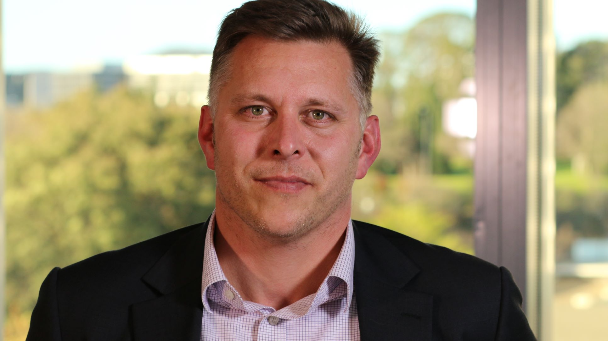
Today’s speaker
Nick Heys
Consumer & Fair Trading Division
Australian Competition & Consumer Commission

Slide 3
Guidance for businesses making environmental claims
18 October 2023

Slide 4
8 Principles For truthful, accurate and clear claims
Make accurate and truthful claims
Have evidence to back up your claims
Don’t leave out or hide important information
Explain any conditions or qualifications on your claims
Avoid broad and unqualified claims
Use clear and easy-to-understand language
Visual elements should not give the wrong impression
Be direct and open about your sustainability transition

Slide 5
1. Make accurate and truthful claims
All your claims should be true and accurate
Even claims that are factually correct can sometimes still mislead consumers
You should consider the overall impression created, including through use of visual elements
Only make claims that represent a genuine environmental impact and do not exaggerate the benefits or level of scientific acceptance of a claim.
Notes:
Principle 1 is about fundamentals…

Slide 6
2. Have evidence to back up your claims
Evidence that is independent and scientific is the most credible.
Making the research, evidence, or data you are relying on easily accessible to consumers helps them understand and trust your claims.
If you are making a representation about a future matter, you must have, and be able to show, that you have reasonable grounds for making it.

Slide 7
3. Don’t leave out or hide important information
Consumers cannot make informed decisions if:
You don’t give them all the relevant information.
Important information is placed where they are unlikely to notice it.
You cannot rely on disclaimers, disclosures or clarifications buried in small print, or otherwise not displayed prominently enough compared to your headline claim, as an excuse for making misleading environmental claims.
Image credit - Investopedia

Slide 8
4. Explain any conditions or qualifications on your claims
Theoretical environmental benefits, which are not clearly explained, are likely to mislead consumers.
Are there are any conditions that need to be met or steps that need to be taken for your claim to be true?
If claims are only true in certain circumstances, you should explain this to consumers clearly and prominently.
Image credit – makeameme.org

Slide 9
5. Avoid broad and unqualified claims
Broad claims can be interpreted widely and more easily mislead consumers than clear, specific claims that are substantiated.
Ensure that you clearly qualify your claims, with prominent disclaimers, if there are any limitations to them.
Image credit – Shutterstock.com

Slide 10
6. Use clear and easy-to-understand language
Most consumers do not have specialist scientific or industry knowledge.
Use clear and easy-to-understand language.
Avoid technical terms.

Slide 11
7. Visual elements should not give the wrong impression
Visual elements (for example green-coloured packaging, or logos representing a recycling process) can significantly influence a consumer’s impression of the environmental impact of a product or service.
Avoid visual elements that would give the wrong impression about the environmental benefits of your product or service.
You need to consider the overall impression that is created, taking into account not just the words used (or information that is left out), but also visual elements, colours and logos.

Slide 12
8. Be direct and open about your sustainability transition
You should be cautious about making aspirational claims about your future environmental objectives unless you have developed clear and actionable plans detailing how you will achieve those objectives.
If you can transition to more sustainable business operations and want to tell consumers about it, be direct and open.
Transitioning to a more sustainable business model takes time.

Slide 13
Feedback from the consultation
Industry wants more information about:
Emissions and offsets
Certifications and trustmarks
The ACCC’s enforcement posture
Examples that reflect real-world claims
The interaction between APCO guidelines, the ARL and the ACL

Slide 14
Other key points raised during the consultation
Businesses are hesitant to make environmental claims
The community wants to see enforcement action

Slide 15
If you would like to discuss anything further with us we are…
Nick Heys
Carys Trowell
Contact: EnforcementCoordination@accc.gov.au

Slide 16
Questions & Answers
Got a Question? Please post in the Q&A

Slide 17
Stay in touch ….
Visit our website and PS Gateway https://stewardshipexcellence.com.au
Register for Centre updates https://stewardshipexcellence.com.au/contact/
Join us on Linkedin https://www.linkedin.com/company/product-stewardship-centre-of-excellence
Write to us at info@stewardshipexcellence.com.au

